Slide 1
RETRIEVAL OF
DATA

Slide 2
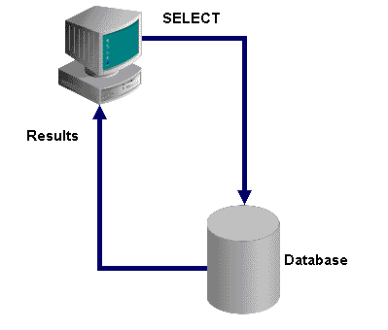
Data Retrieval
You use SQL statements to store, manage and retrieve data in the database.
To retrieve data from the database, the SQL statement that is used is the SELECT statement.

Slide 3
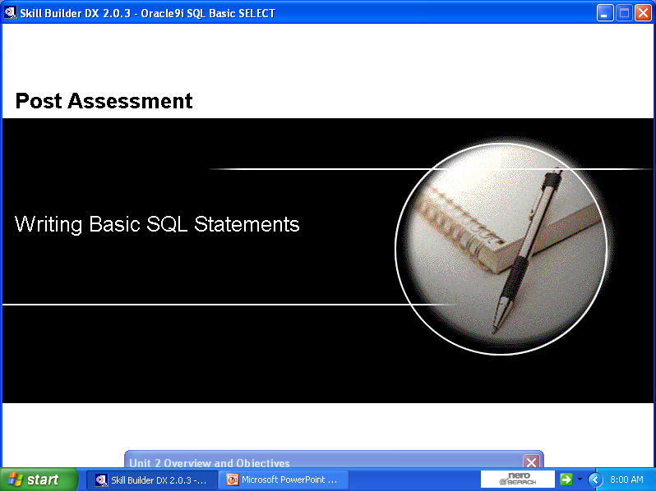

Slide 4
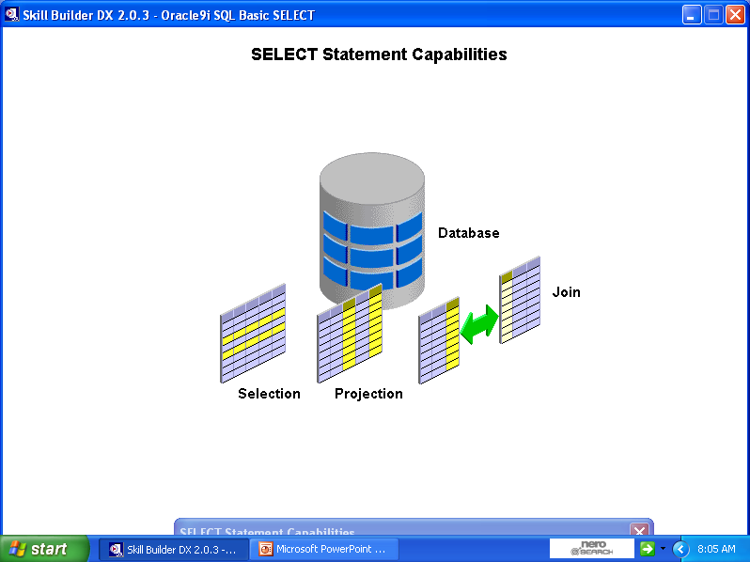
SELECT Statement Capabilities
You can use the selection capability of SQL to choose the rows that you want to retrieve from a table. You can specify various criteria while selecting the rows that you want to see.
You can use the projection capability of SQL to choose the columns in a table that you want to retrieve. You can retrieve selected columns or all columns in a table.
You can join data that is stored in different tables by creating a link between the data in the tables. In addition, you can retrieve data from multiple tables.

Slide 5
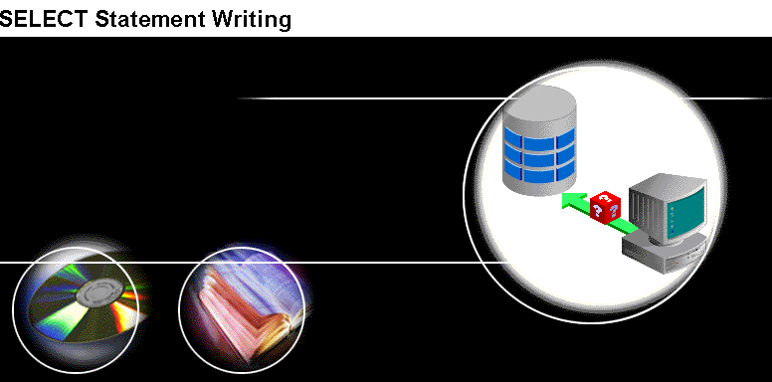

Slide 6
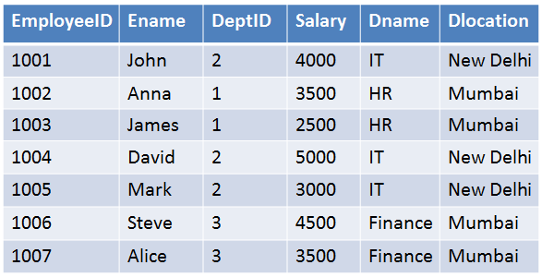
TABLE NAME: EMPLOYEE

Slide 7
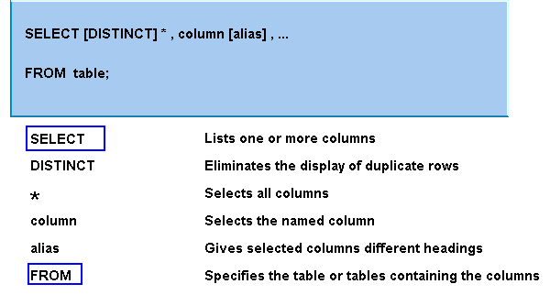
SELECT Statements: Syntax

Slide 8
SELECT Statements: Syntax
The SELECT statement must include a SELECT clause and a FROM clause.
The words SELECT and FROM are called keywords. A keyword starts an individual SQL clause or an element
The SELECT clause specifies the columns that you want to display.
The FROM clause specifies the tables that contain those columns.
The DISTINCT clause is optional. You use the DISTINCT clause only when you need to eliminate the display of duplicate rows.
A clause refers to part of a SQL statement. In the example given below, the SQL statement has two clauses. One of the clauses is the SELECT * statement and the other clause is the FROM employees; statement.
A statement is a combination of clauses placed in a specific order.
Placing a semi-colon at the end of the statement is the way of executing a SQL statement.
SELECT *
FROM employees;

Slide 9
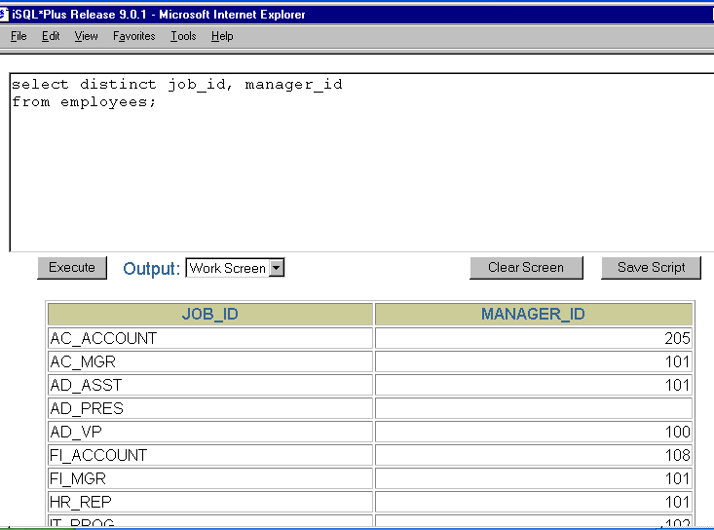

Slide 10
SELECT Statements: Guidelines
You first need to enter a keyword to start a SQL statement. The keywords cannot be abbreviated.
You can add subsequent keywords on different lines. You need to press the Enter key to go to the next line. To enhance readability, place each clause on a separate line.
SQL statements are not case sensitive. However, for readability, you typically enter keywords in uppercase. All other words, such as table names and column names are entered in lowercase.

Slide 11
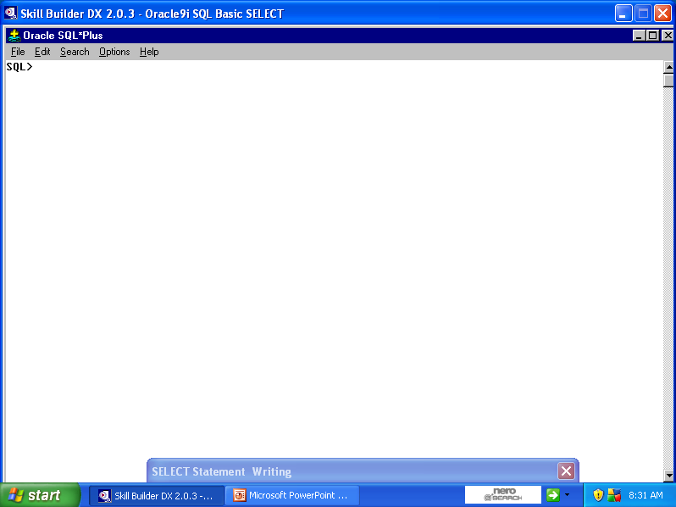
The Tools Used
You can use the SQL *Plus or the iSQL *Plus tool to write and submit the SQL statements to the Oracle server for execution.
SQL *Plus is an Oracle tool that is used to write SQL statements. The SQL *Plus window is displayed.
You need to first log on to SQL *Plus to access the SQL *Plus window.

Slide 12
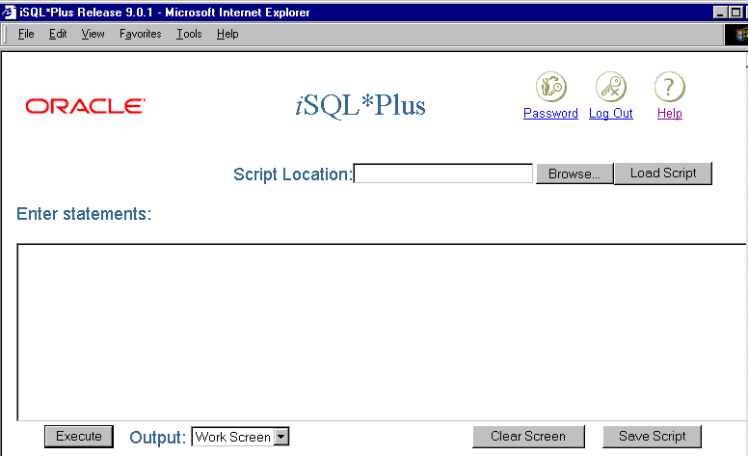
The Tools Used
iSQL *Plus is a browser-based interface. You can access the iSQL *Plus environment window through any browser. The iSQL *Plus environment is also used to submit the SQL statements to the Oracle server for execution.

Slide 13
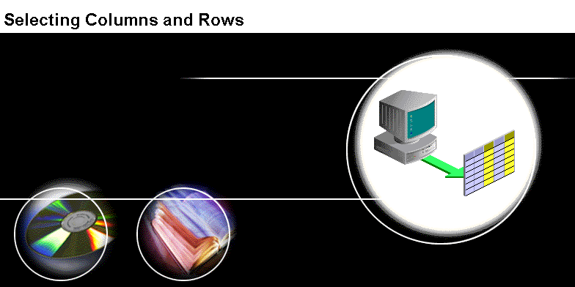

Slide 14
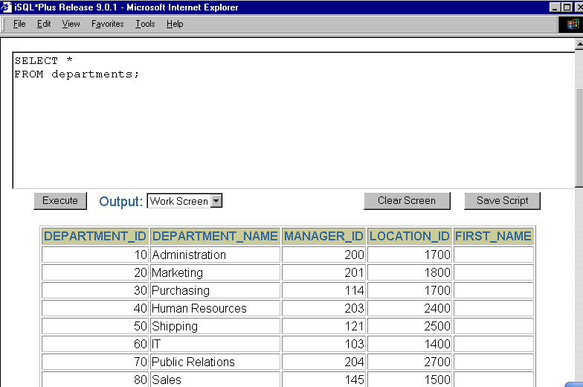
To display all columns of data in a table, you place an asterisk after the SELECT keyword. The asterisk represents all columns in a table.
To execute the statement, you place a semi-colon at the end of the last line in the statement and click the Execute button.
When you execute the statement, all columns from the table are displayed.

Slide 15
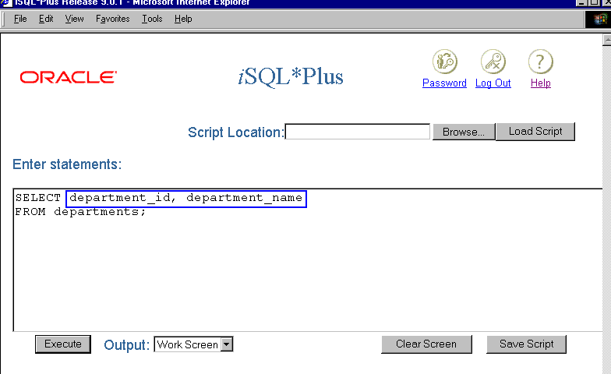
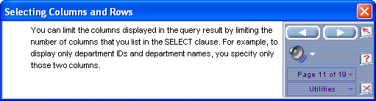

Slide 16
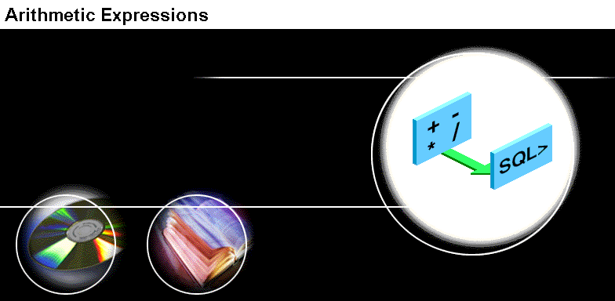

Slide 17
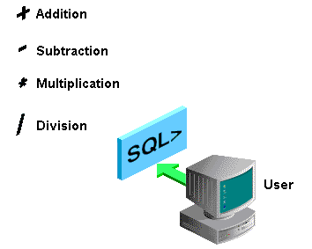
Arithmetic Operators
You may need to modify the way in which data is displayed, perform calculations, or look at what-if scenarios.
An arithmetic expression may contain column names, constant numeric values, and the arithmetic operators.
The arithmetic operators available in SQL are: addition, subtraction, multiplication, and division.
You can use arithmetic operators in any clause of a SQL statement except the FROM clause.

Slide 18
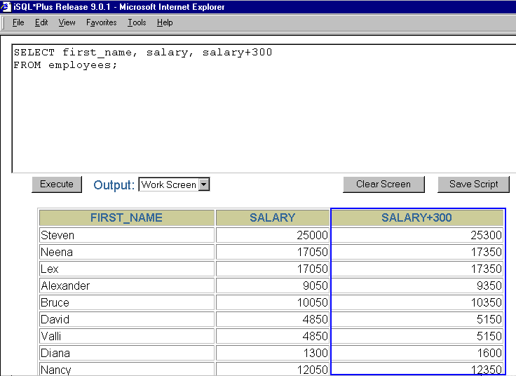

Slide 19
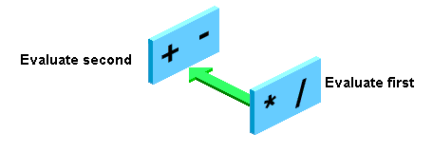
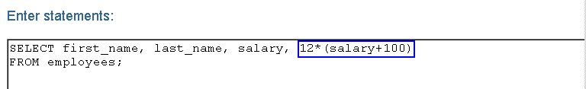
Rules Of Precedence
Multiplication and division take priority over addition and subtraction.
Operators of the same priority are evaluated from left to right.
Parentheses are used to force prioritized evaluation and to clarify statements.

Slide 20
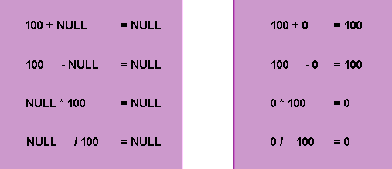
Arithmetic Expressions With NULL Values
When you perform arithmetic operations on NULL values, the result is always NULL.
A empty field is said to contain NULL.
A NULL value is defined as a value that is unavailable, unassigned, unknown, or inapplicable. A NULL value is not the same as zero or space.

Slide 21
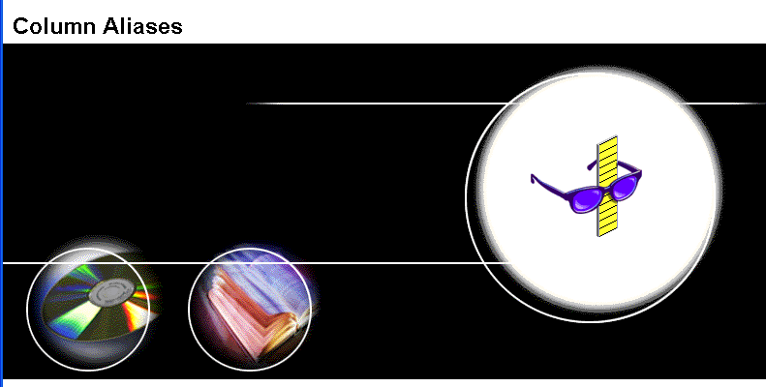

Slide 22
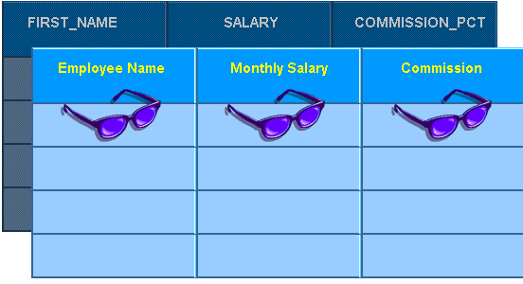
Using Column Alias
You can use a column alias to assign a different name to a column heading.
By using an alias, you can display a more descriptive heading for a column.
It is also useful with calculations.

Slide 23
Using Column Alias
SELECT FirstName As Name, Commission As Comm
FROM Employees;
Or
SELECT FirstName “Name”, Commission “Monthly Comm”
FROM Employees;
You specify an alias after the appropriate column name or expression in the SELECT list.
You separate the column name and the alias with a minimum of one space.

Slide 24
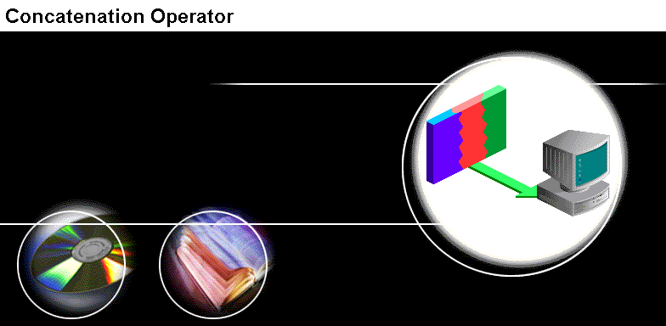

Slide 25
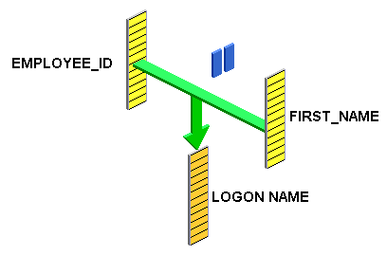
Concatenation Operator
You can use the concatenation operator to concatenate or link columns to other columns, arithmetic operators, or constant values.
When you link a column to one of these elements, the output displays a single column that is a character expression.
The concatenation operator is represented by two vertical bars.
Columns on either side of the operator are combined to display a single column.

Slide 26
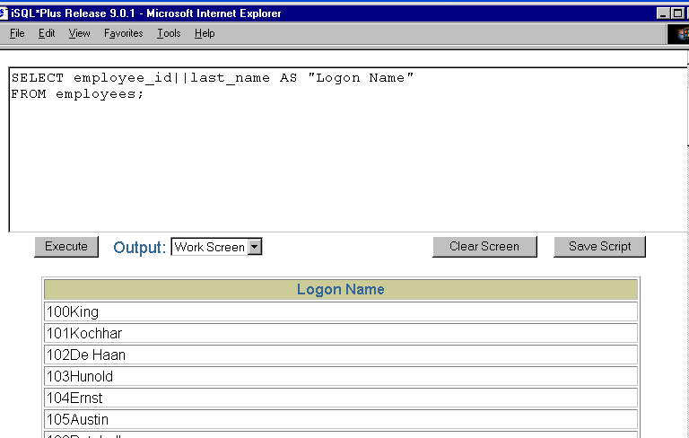

Slide 27
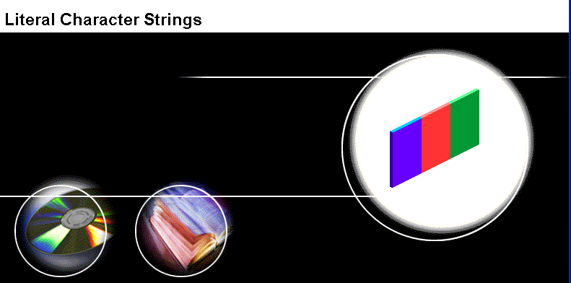

Slide 28
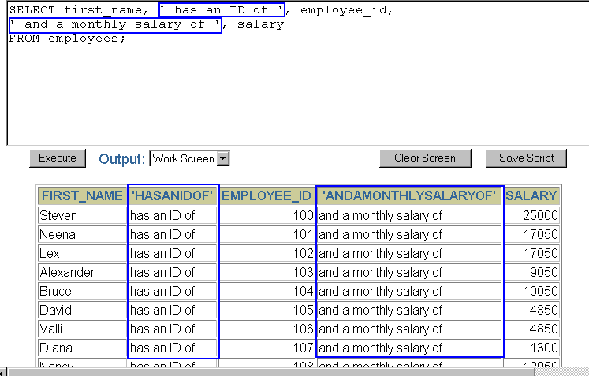
Literal Character Strings
A literal is a character, a number, or a date included in the SELECT list.
Date and character literal values must be enclosed within single quotation marks (‘ ‘); number literals need not.
Each character string is output once for each row returned.

Slide 29


Slide 30
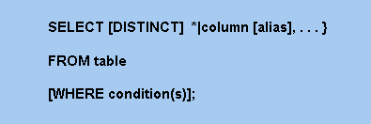
The WHERE Clause
By inserting a WHERE clause into a SQL statement, you can specify a condition that must be met, and only the rows that meet the condition are returned. This is also known as selection.
The WHERE clause directly follows the FROM clause in the SQL statement syntax.
The WHERE clause consists of the WHERE keyword and a condition or conditions.

Slide 31
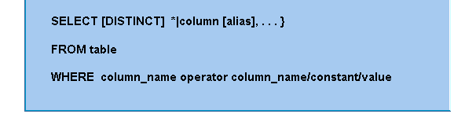
The WHERE Clause Condition
The condition in a WHERE clause specifies a comparison of values that limits the rows returned by a query.
The condition consists of three elements.
First is a column name, second is a comparison operator and third element can be another column name, constant, or list of values.

Slide 32
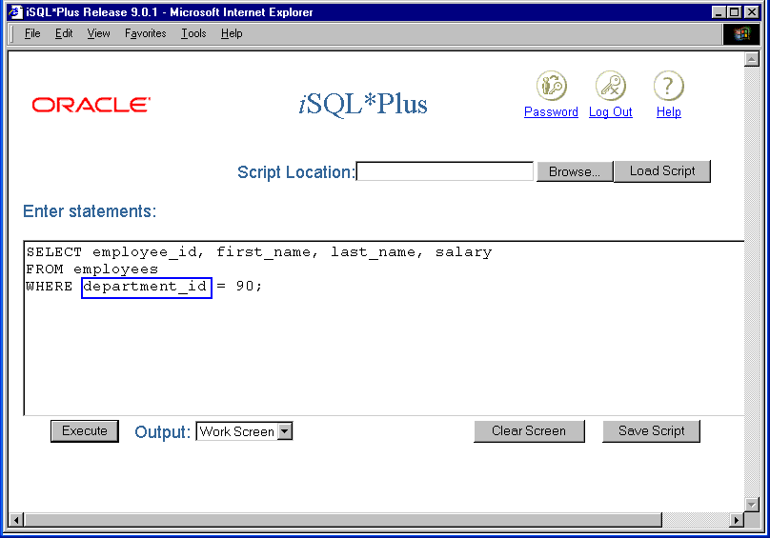

Slide 33
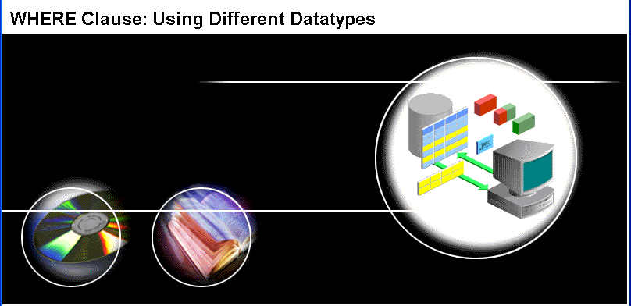

Slide 34
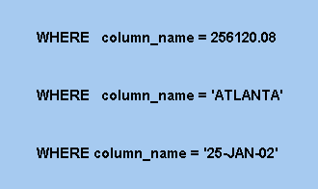
The WHERE Clause Guidelines
SQL uses single quotes around text values (most database systems will also accept double quotes).
Numeric values should not be enclosed in quotes.

Slide 35

Operators Used

Slide 36
Operators Allowed in the WHERE Clause
With the WHERE clause, the following operators can be used:
Operator | Description
= | Equal
<> | Not equal
> | Greater than
< | Less than
>= | Greater than or equal
<= | Less than or equal
BETWEEN…AND | Between an inclusive range
LIKE | Search for a pattern
IN | If you know the exact value you want to return for at least one of the columns
IS NULL | Is a null value
Note: In some versions of SQL the <> operator may be written as !=

Slide 38
Using Comparison Operators: Few Examples
SELECT *
FROM Persons
WHERE P_Id < 3;
SELECT *
FROM Persons
WHERE P_Id BETWEEN 1 AND 3;
SELECT *
FROM Persons
WHERE P_Id IN (1, 3);
SELECT *
FROM Persons
WHERE P_Id <> 3;

Slide 39
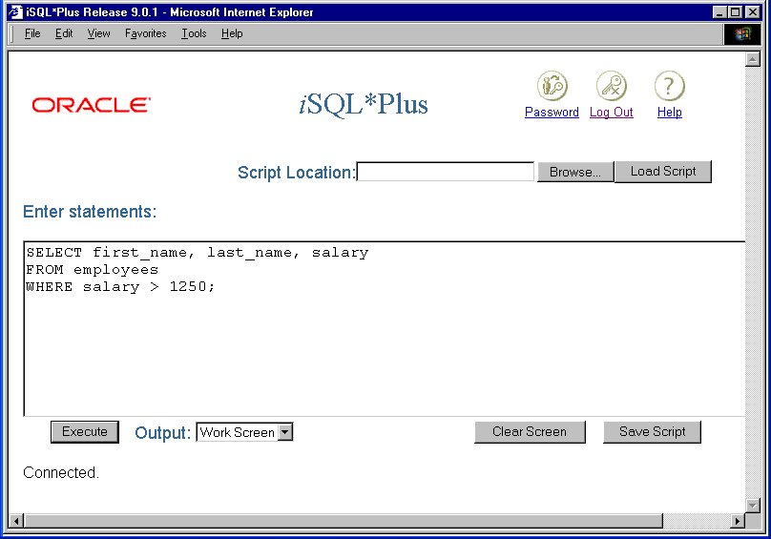

Slide 40


Slide 41
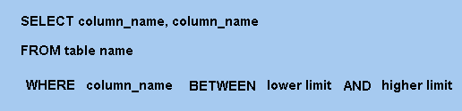
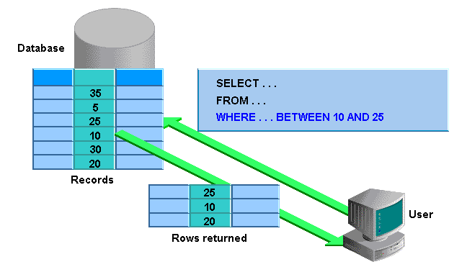
BETWEEN Operator: Syntax

Slide 42
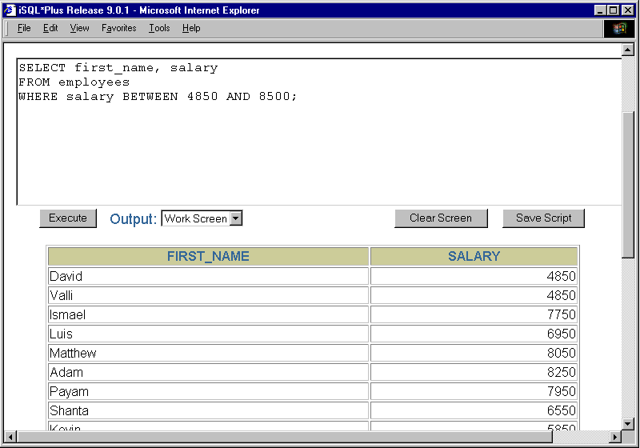

Slide 43
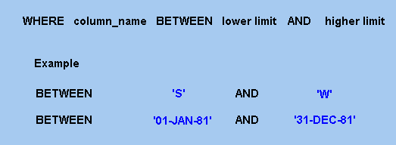
BETWEEN Operator With Character
and Date Values

Slide 44
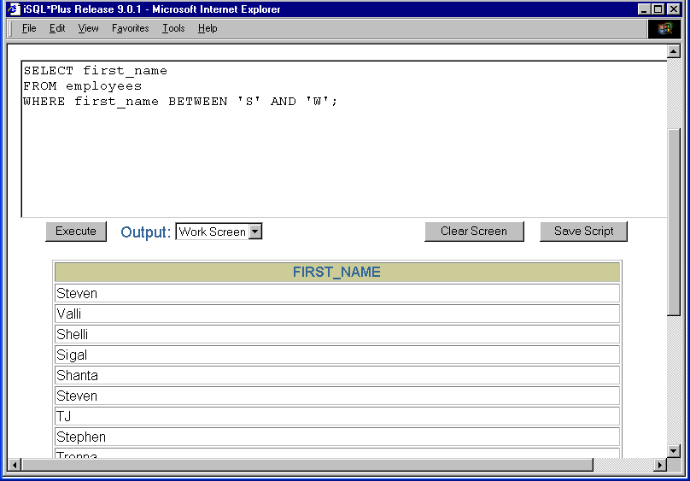

Slide 45
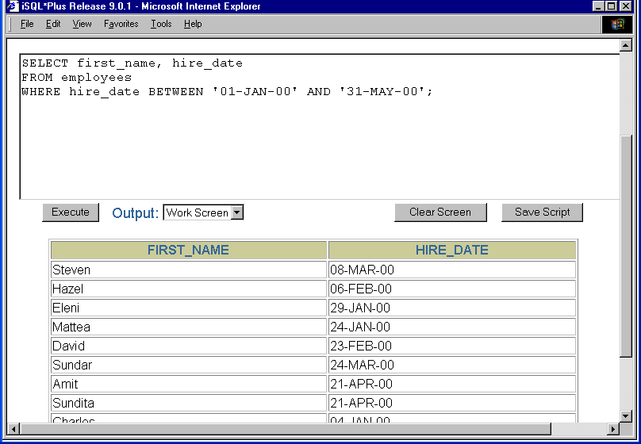

Slide 46


Slide 47
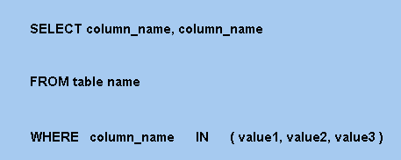
IN Operator: Syntax
You can use the IN operator if you know the exact value you want to return for at least one of the columns

Slide 48
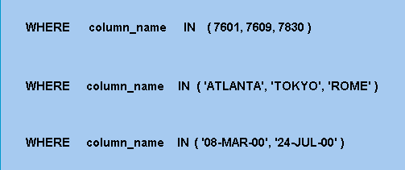
IN Operator With Different Data Types

Slide 49
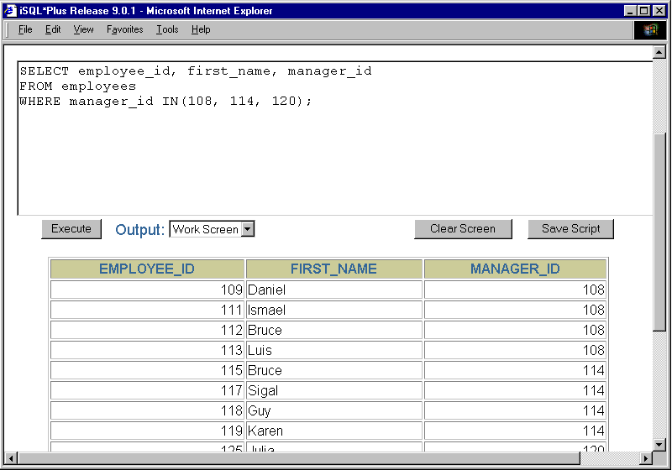

Slide 50
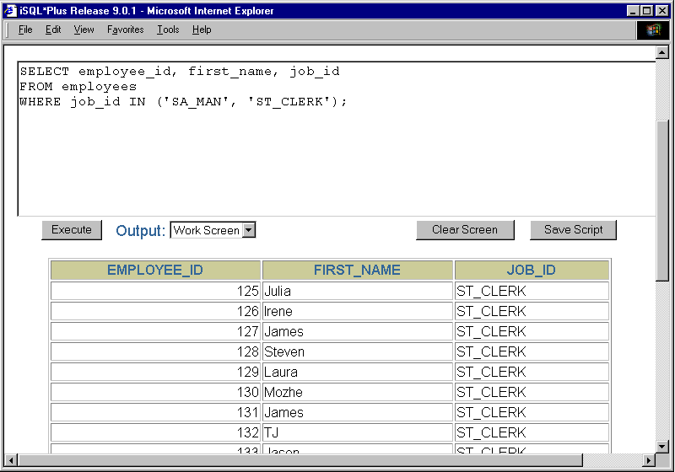

Slide 51


Slide 52
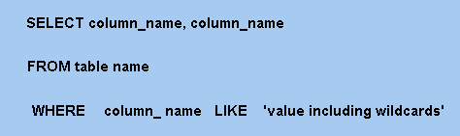
LIKE Operator: Syntax
You can select rows that match a character pattern by using the LIKE condition.
The character-pattern matching operation is referred to as a wildcard search.
Two symbols can be used to construct the search string, as given below:
Symbol | Description
% | Represents any sequence of zero or more characters
- | Represents any single character

Slide 53
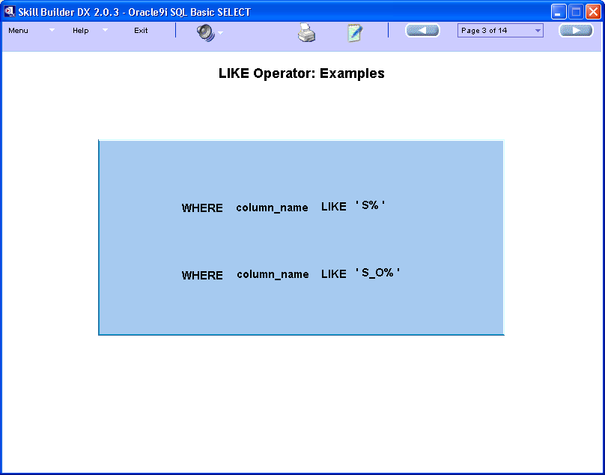
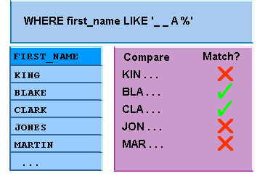
LIKE Operator Examples

Slide 54
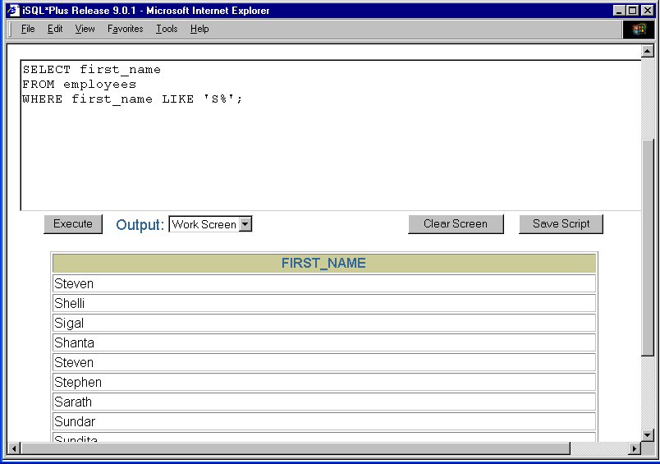

Slide 55
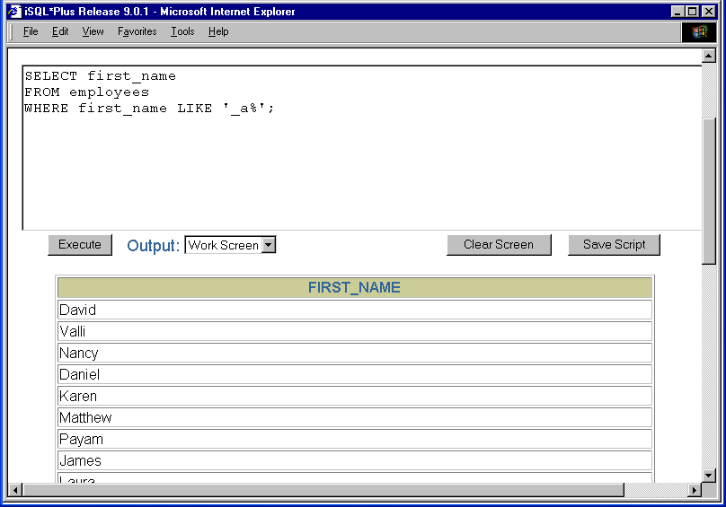

Slide 56


Slide 57
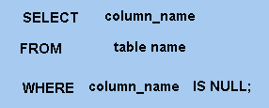
IS NULL Operator: Syntax
The NULL conditions include the IS NULL condition and the IS NOT NULL condition.

Slide 58
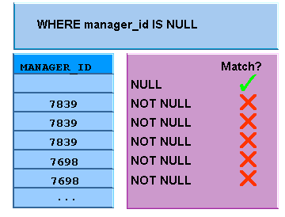
IS NULL Operator: Example

Slide 59
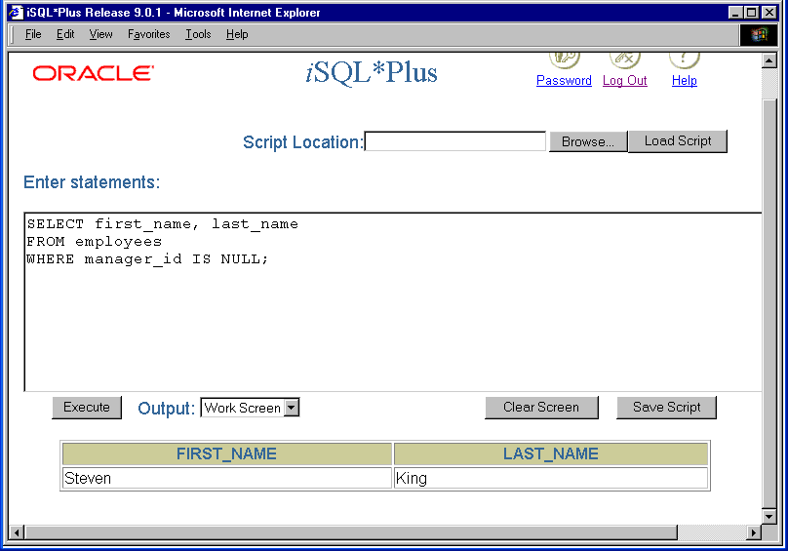

Slide 60

Logical Conditions

Slide 61
Logical Operators
A logical condition combines the result of two component conditions to produce a single result based on them or inverts the result of a single condition.
Logical Operator | Meaning
AND | Returns TRUE if both component conditions are true
OR | Returns TRUE if either component condition is true
NOT | Returns TRUE if the following condition is false

Slide 63

AND Operator: Syntax

Slide 64

AND Operator: Example

Slide 65


Slide 66


Slide 67
OR Operator

Slide 68

OR Operator: Syntax

Slide 69

OR Operator: Example

Slide 70


Slide 71


Slide 72


Slide 73

NOT Operator: Syntax

Slide 74

NOT Operator: Placement

Slide 75


Slide 76


Slide 77


Slide 78
Rules Of Precedence
The rules of precedence determine the order in which expressions are evaluated and calculated. The table below lists the default order of precedence. You can override the default order by using parentheses around the expressions you want to calculate first.
Order Evaluated | Operator
1 | Arithmetic Operators
2 | Concatenation Operator
3 | Comparison Conditions
4 | IS [NOT] NULL, LIKE, [NOT] IN
5 | [NOT] BETWEEN
6 | NOT logical condition
7 | AND logical condition
8 | OR logical condition

Slide 79


Slide 80


Slide 81


Slide 82

ORDER BY Clause: Syntax
The ORDER BY Clause can be used in a SELECT statement to restrict the number of rows.
If you use the ORDER BY clause, it must be the last clause of the SQL statement.

Slide 83
ORDER BY Clause: Example
In the first example, the rows are sorted in ascending order (this is the default order) and in the second example, DESC orders the rows in descending order.
SELECT *
FROM Employees
ORDER BY salary;
SELECT *
FROM Employees
ORDER BY salary DESC;

Slide 84


Slide 85


Slide 86


Slide 87

Sorting By Multiple Columns: Syntax

Slide 88


Sorting By Multiple Columns: Example

